Slide 1




BINARY
COMPARATOR

Slide 2

NAME : ZINZUVADIYA KRISH
ENROLL NO. : 23002170210138
BRANCH : IT
BATCH : C2
NAME : MEHTA PREET
ENROLL NO. : 23002170210056
BRANCH : IT
BATCH : C2
NAME : FALDU DHRUV
ENROLL NO. : 23002170210027
BRANCH : IT
BATCH : C2
NAME : SAVALIYA KRIS
ENROLL NO. : 23002170210115
BRANCH : IT
BATCH : C2
NAME : PATEL HET
ENROLL NO. : 23002170310007
BRANCH : CSD
BATCH : C2

Slide 3


INTRODUCTION
A 1-bit binary comparator is a digital logic circuit that compares two single-bit binary numbers (A and B).
It determines the relationship between A and B and outputs whether
A > B
A = B
A < B

Slide 4


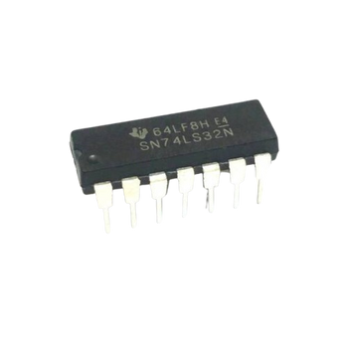
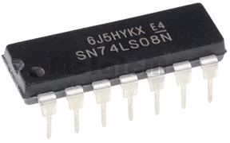

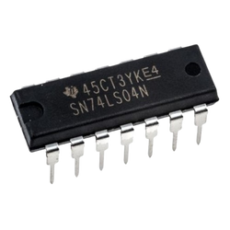
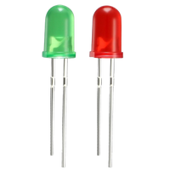
COMPONENT
AND Gate (IC 7408): Used to generate the condition for A > B and A < B by combining input signals logically
OR Gate (IC 7432): Used to combine multiple conditions to generate final outputs.
NOT Gate (IC 7404): Used to invert input signals for required conditions.

Slide 5
APPLICATIONS
Basic Comparison Operations: Used in simple decision-making circuits where single-bit values need to be compared.
Multi-bit Comparators: Acts as a building block for n-bit comparators, where multiple 1-bit comparators are cascaded.
Digital Logic Circuits: Used in control circuits where logical comparisons are needed.
ALU Operations: Helps in arithmetic logic units (ALUs) for decision-making tasks like conditional branching.

Slide 6

BENEFITS
LIMITATIONS
Fast Comparison
Simple Design
Low Power Consumption
Widely Used
Reliable and Accurate
Limited to Binary Numbers
Fixed Bit Width
Increased Complexity with More Bits
Hardware Scalability
Not Suitable for Large

Slide 7



CONCLUSION
Efficient Comparison
BASIC LOGIC DESIGN
ADAPTABILITY
The comparator provides a fast and reliable method for comparing binary values.
Implementing the circuit with 7408 (AND), 7432 (OR), and 7404 (NOT) ICs reinforces logic gate concepts.
Can be extended to higher-bit comparators for more complex computations.

Slide 8
THANK
YOU!

